Slide 1
Chapter 7
Circular and Rotational Motion

Slide 2
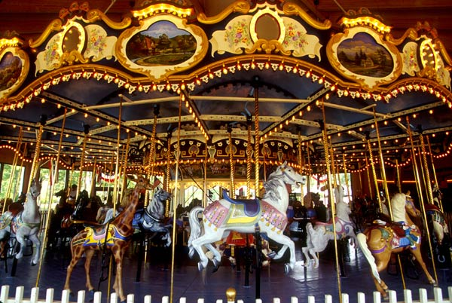
Ponder this:
On a carousel, does the speed of a horse change when it is further from the center of the carousel?

Slide 3
On a carousel, where is the speed of the carousel the greatest?
Close to the center
Midway between the center and the outside
Close to the outer horses
All move at the same speed
Ans

Slide 4
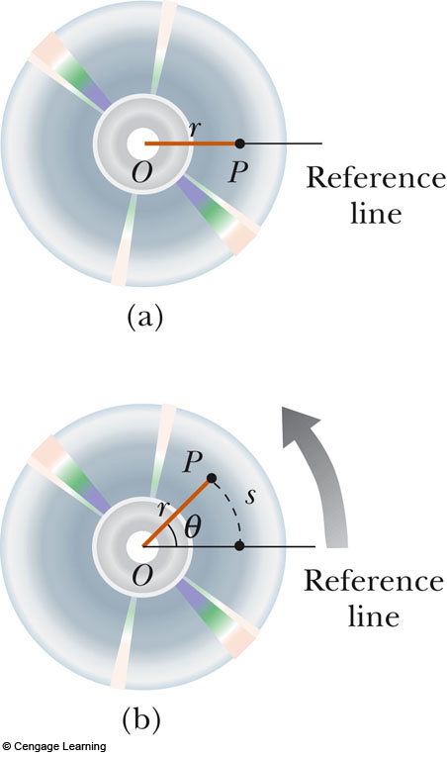
Angular Displacement
Axis of rotation is the center of the disk
Need a fixed reference line – similar to a reference point in linear motion

Slide 5
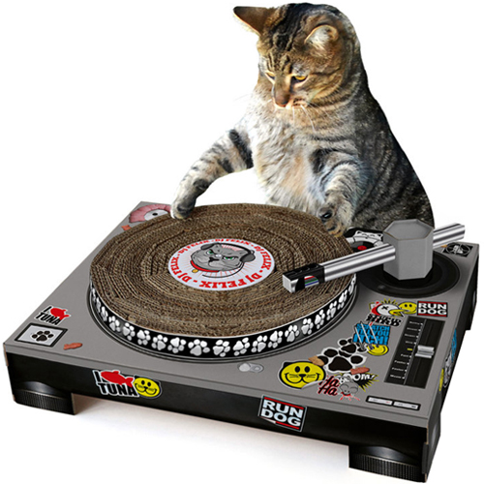
Angular Displacement, cont.
The angular displacement is defined as the angle the object rotates through during some time interval

Slide 6
Linear and Rotational Analogs
Linear
𝛥x (linear displacement) or s (arc length) (in m)
v (linear or tangential velocity) (in m/s)
a (linear acceleration) (in m/s²)
Rotational
𝛥𝜭 (angular displacement) (in radians
𝝎 (angular speed) (in rad/s)
𝜶 (angular acceleration) (in rad/s²)

Slide 7
Analogies Between Linear and Rotational Motion

Slide 8
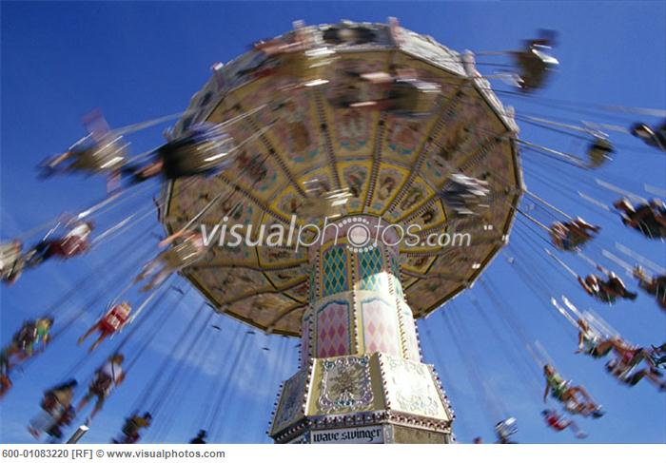
Conversions Between Angular and Linear Quantities
Displacements
Speeds
Accelerations
Every point on the rotating object has the same angular motion
Every point on the rotating object does not have the same linear motion

Slide 9
Tangential Velocity
Tangential Velocity can be calculated by considering how fast something rotates at a given radius
V_{t} is the tengential speed
r is the radius
T is the period of rotation (how long for 1 cycle)
f is the frequency of the rotation (how many cycles per second)
Period (T) and frequency (f) are inverses of each other

Slide 10
Tangential Velocity
The Cedar Downs Racing Derby has a radius of 20.0m. If a normal rider travels around the circular ride in 2 minutes (120 seconds), what is their tangential velocity?

Slide 11
Tangential Velocity
An electric motor’s drive shaft has a radius of 5mm, and spins 3000 times per second. What is the tangential velocity at the exterior of the drive shaft?

Slide 12
Centripetal Acceleration
An object traveling in a circle, even though it moves with a constant speed, will have an acceleration
The centripetal acceleration is due to the change in the direction of the velocity

Slide 13
Centripetal Acceleration, cont.
Centripetal refers to “center-seeking”
The direction of the velocity changes
The acceleration is directed toward the center of the circle of motion

Slide 14
Centripetal Acceleration, final
The magnitude of the centripetal acceleration is given by
This direction is toward the center of the circle

Slide 15
Forces Causing Centripetal Acceleration
Newton’s Second Law says that the centripetal acceleration is accompanied by a force
F_{C} = ma_{C}
F_{C} stands for any force that keeps an object following a circular path
Tension in a string
Gravity
Force of friction

Slide 16
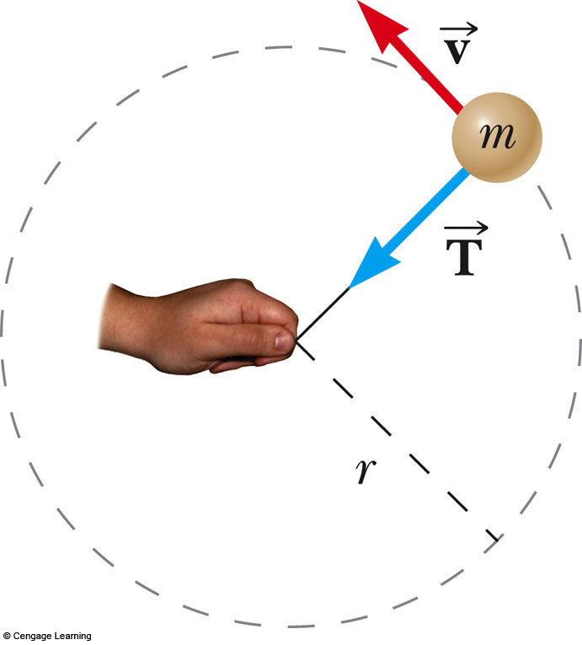
Centripetal Force Example
A ball of mass m is attached to a string
Its weight is supported by a frictionless table
The tension in the string causes the ball to move in a circle

Slide 17
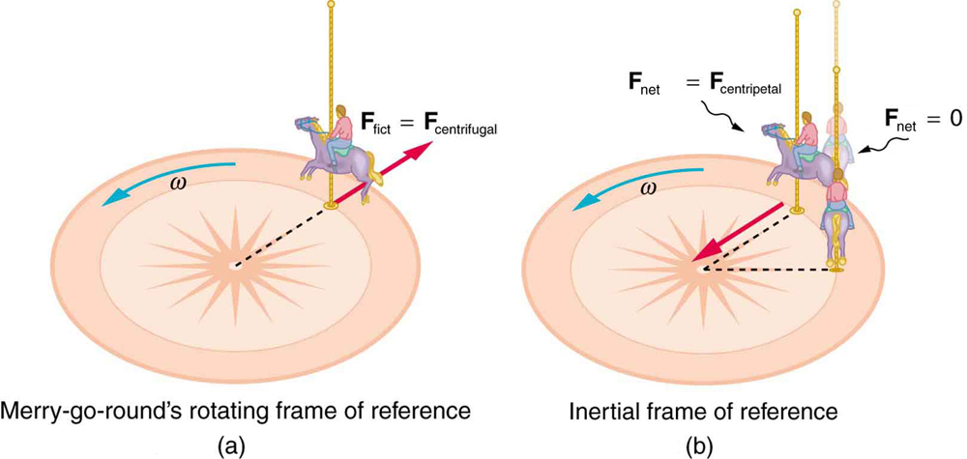
Fictitious Centrifugal Force
The Centrifugal force that is felt is a consequence of special relativity.
It is an incorrect way to interpret the situation.

Slide 18
Centripetal & Tangential Motion

Slide 19
Centripetal Force
General equation
If the force vanishes, the object will move in a straight line tangent to the circle of motion
Centripetal force is not a force in itself.
****Centripetal force is the net force on an object moving in circular motion (usually due to a combination of forces)

Slide 20
Centripetal Force cont.
General equation
Note: Centripetal force is not a specific classification of force (like friction or tension)
****Centripetal force is the net force on an object moving in circular motion (usually due to a combination of forces)

Slide 21
When a car takes a curve at a constant speed, the centripetal force is due to …
Frictional force
Circular force
Tensional force
Gravitational force

Slide 22
When a you swing a lasso above your head, the centripetal force is due to …
Frictional force
Circular force
Tensional force
Gravitational force

Slide 23
The centripetal force that causes the moon to orbit the Earth is due to:
Frictional force
Circular force
Tensional force
Gravitational force

Slide 24
Comparison of all three types of Circular Motion
Angular motion
Tangential motion
Centripetal Motion
Describes rotation directly using radians
Angular displacement
θ → rad
Angular velocity
ω → rad/s
Angular acceleration
α → rad/s²
Describes what is happening rotationally with a snapshot of the tangent in “normal units”
Arc length
S → m
Tangential velocity
V_{t} → m/s
Tangential acceleration
a_{t} → m/s²
Acceleration toward the center of the circle (that keeps an object moving in a circle)
Parallel to the radius of the circle
Centripetal acceleration (a_{c})
Centripetal Force (F_{c})

Slide 25
Angular Motion | Tangential Motion | Centripetal Motion
Describes the angle of rotation around a circular path using radians (regardless of radial distance) | Describes the motion of an object along a circular path in terms of meters traveled (depends on radial distance) | Motion or forces that are directed toward the center of the circle (keep objects moving in circular paths)
rad | m | N
rad/s | m/s
rad/s² | m/s² | m/s²
θ
s
r

Slide 26
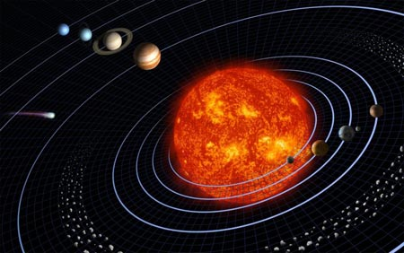
Newton’s Law of Universal Gravitation
Gravitational force is directly proportional to the masses of the objects and inversely proportional to the distance between the objects.
Full Distance between two centers of mass (not radius)

Slide 27
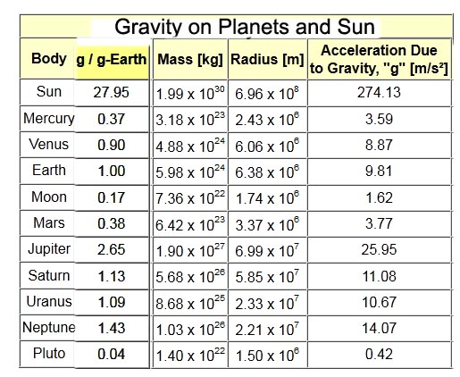
Equals ‘g’

Slide 28
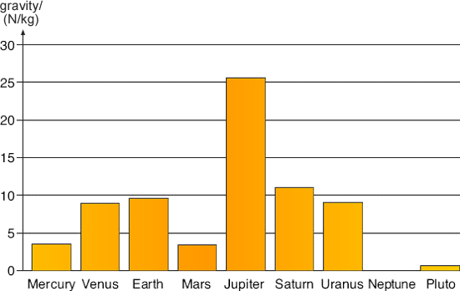

Slide 29
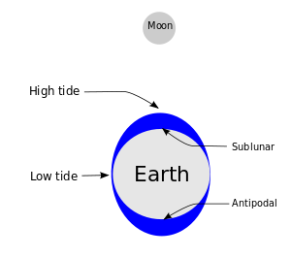
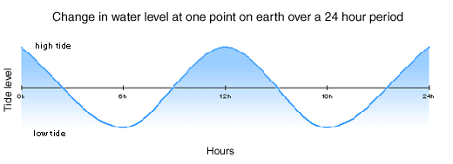
Effects of Gravity
Ocean tides – due to the gravitational pull of the moon on large bodies of water

Slide 30
Orbiting objects are in freefall

Slide 31
Newton’s Law of Universal Gravitation
According to Newton, the amount of gravity between two objects is affected by both mass (m) and distance between the centers of the objects (r)
G – determined by Henry Cavendish, not Newton

Slide 32
Newton’s Law of Universal Gravitation
G = Newton’s Gravitational Constant
6.673 x 10⁻¹¹ Nm²/kg²
r = distance between center of objects in meters
m₁ and m₂ = mass of objects (kg)

Slide 33
Inverse Square Law

Slide 34
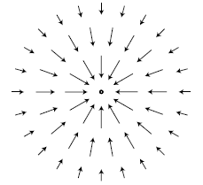
Field Force
Gravitational Force is a field force.
The vectors show gravitational force vectors within Earth’s gravitational field.

Slide 35
If you fly from NYC (sea level) to Denver, your weight will … (assuming you do not eat, drink, excrete, …)
Increase
Decrease
Stay the same

Slide 36
You travel to another planet that has twice the radius of Earth but is twice Earth’s mass. Your weight on this planet compared to Earth is …
More
Less
The same
Unable to be determined

Slide 37
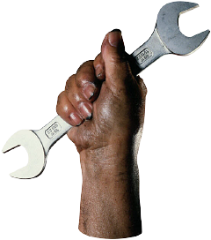
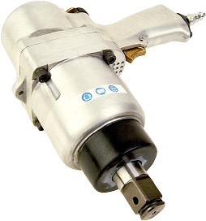
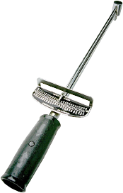
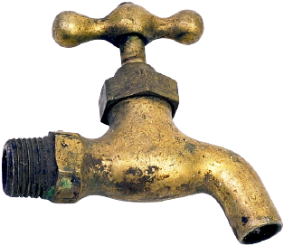
Torque

Slide 38
Definition of Torque
Torque is defined as the tendency to produce a change in rotational motion.

Slide 39
Torque is Determined by Three Factors:
The magnitude of the applied force.
The direction of the applied force.
The location of the applied force.
Magnitude of force
The 40-N force produces twice the torque as does the 20-N force.
Location of force
Each of the 20-N forces has a different torque due to the direction of force.
Direction of Force
The forces nearer the end of the wrench have greater torques.
20 N
θ
20 N
20 N
θ
20 N
20 N
40 N
20 N
20 N

Slide 40
Units for Torque
Torque is proportional to the magnitude of F and to the distance r from the axis. Thus, τ = Fr
τ = Fr
Units: N⋅m
τ = (40 N)(0.60 m)
= 24.0 N⋅m
6 cm
τ = 24.0 N⋅m
40 N

Slide 41
Sign Convention for Torque
By convention, counterclockwise torques are positive and clockwise torques are negative.
ccw
Positive torque: Counter-clockwise, out of page
cw
Negative torque: clockwise, into page

Slide 42
The Moment Arm
The moment arm (r) of a force is the perpendicular distance from the line of action of a force to the axis of rotation.
Location of force
The forces nearer the end of the wrench have greater torques.
20 N
20 N
20 N

Slide 43
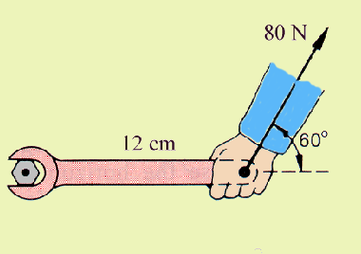
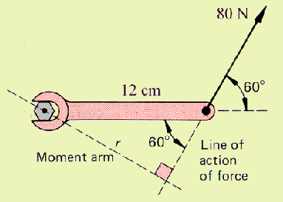
Example 1: An 80-N force acts at the end of a 12-cm wrench as shown. Find the torque.
Extend line of action, draw, calculate r.
r = 12 cm sin 60⁰ = 10.4 cm
τ = (80 N)(0.104 m) = 8.31 N m

Slide 44
Alternate: An 80-N force acts at the end of a 12-cm wrench as shown. Find the torque.
positive
12 cm
Resolve 80-N force into components as shown.
Note from figure: r_{x} = 0 and r_{y} = 12 cm
τ = (69.3 N)(0.12 m)
τ = 8.31 N m as before

Slide 45
Rotational Equilibrium
If ΣΤ = 0, the system is in rotational equilibrium.
Be sure to note the signs of each force (counterclockwise = positive, clockwise = negative) when adding the torques.

